Slide 1
Unit 4
(Mathematics for Data science Probability)

Slide 2
Introduction to Probability
Probability is a branch of mathematics that deals with uncertainty and randomness. In data science, probability provides the foundation for understanding uncertainty in data, making predictions, building statistical models, and supporting decision-making under uncertainty.
In real-world data science problems, outcomes are rarely deterministic. Probability helps quantify how likely an event is to occur and forms the backbone of machine learning, statistics, risk analysis, and predictive modeling.
Basic Concepts of Probability
1 Random Experiment
A random experiment is an experiment whose outcome cannot be predicted with certainty.
Example:
Tossing a coin
Rolling a dice
Selecting a customer randomly from a database
2 Sample Space (S)
The sample space is the set of all possible outcomes of a random experiment.
Example: Rolling a die → S = {1, 2, 3, 4, 5, 6}

Slide 3
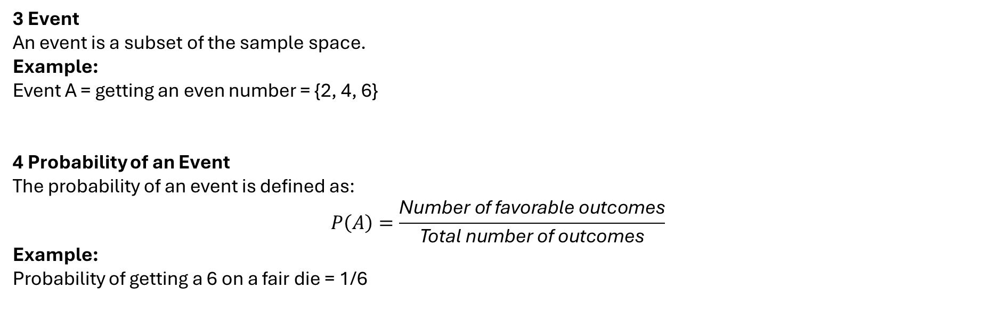
3 Event
An event is a subset of the sample space.
Example: Event A = getting an even number = {2, 4, 6}
4 Probability of an Event
The probability of an event is defined as:
$$P\left(A\right)=\frac{\text{Number} \text{of} \text{favorable} \text{outcomes}}{\text{Total} \text{number} \text{of} \text{outcomes}}$$
Example: Probability of getting a 6 on a fair die = 1/6

Slide 4
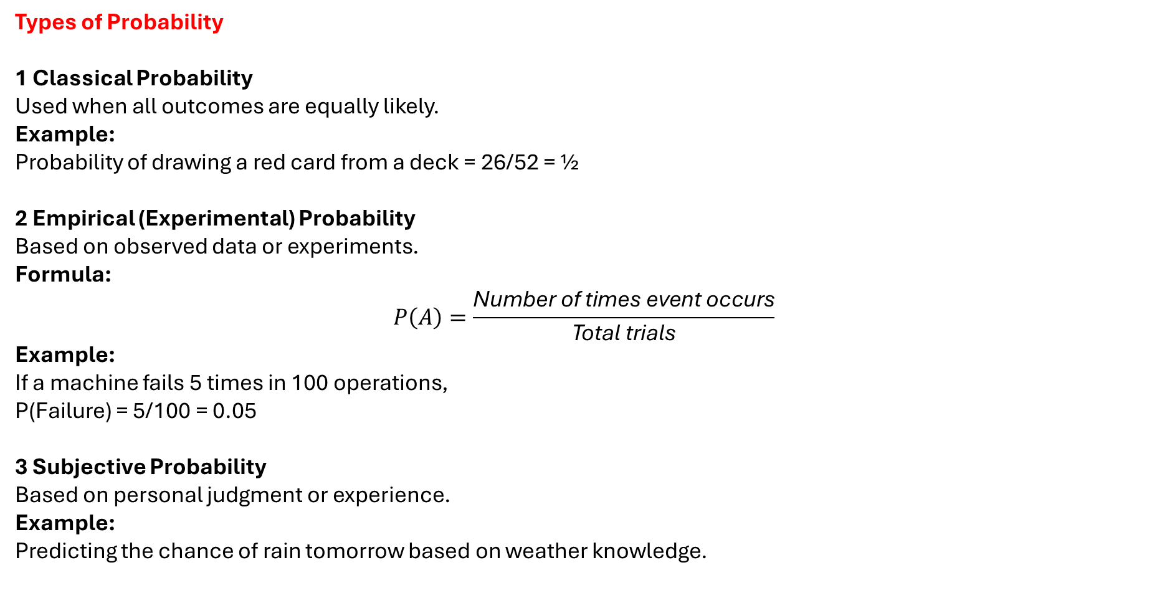
Types of Probability
1 Classical Probability
Used when all outcomes are equally likely.
Example: Probability of drawing a red card from a deck = 26/52 = ½
2 Empirical (Experimental) Probability
Based on observed data or experiments.
Formula:
$$P\left(A\right)=\frac{\text{Number} \text{of} \text{times} \text{event} \text{occurs}}{\text{Total} \text{trials}}$$
Example: If a machine fails 5 times in 100 operations, P(Failure) = 5/100 = 0.05
3 Subjective Probability
Based on personal judgment or experience.
Example: Predicting the chance of rain tomorrow based on weather knowledge.

Slide 5
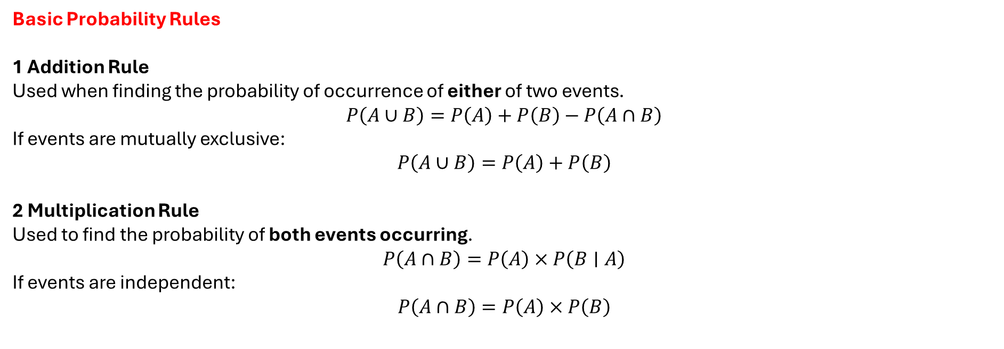
Basic Probability Rules
1 Addition Rule
Used when finding the probability of occurrence of either of two events.
$$P\left(A∪B\right)=P\left(A\right)+P\left(B\right)−P\left(A∩B\right)$$
If events are mutually exclusive:
$$P\left(A∪B\right)=P\left(A\right)+P\left(B\right)$$
2 Multiplication Rule
Used to find the probability of both events occurring.
$$P\left(A∩B\right)=P\left(A\right)×P\left(B∣A\right)$$
If events are independent:
$$P\left(A∩B\right)=P\left(A\right)×P\left(B\right)$$

Slide 6
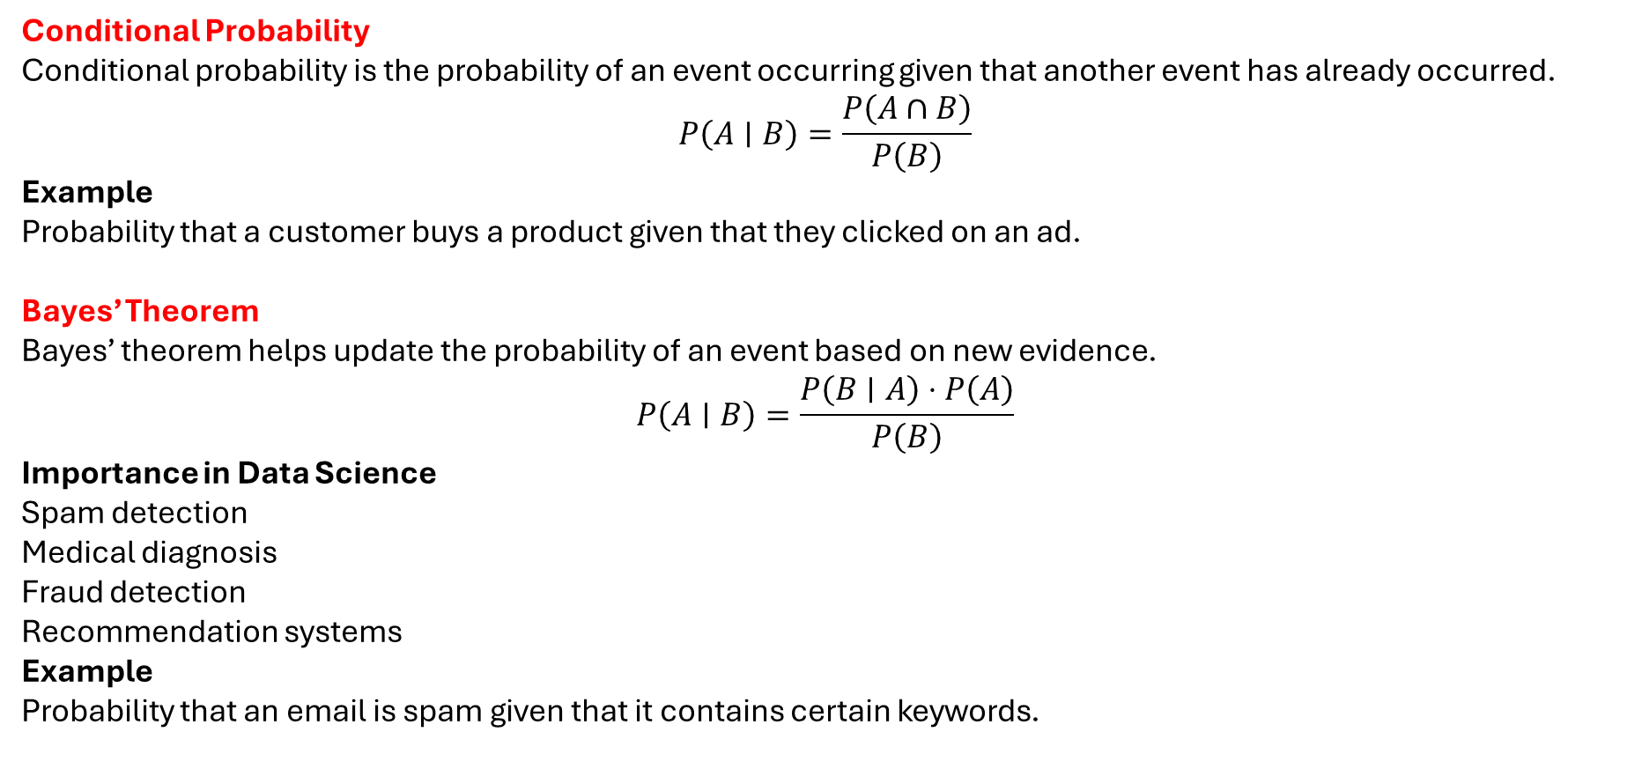
Conditional Probability
Conditional probability is the probability of an event occurring given that another event has already occurred.
$$P\left(A∣B\right)=\frac{P\left(A∩B\right)}{P\left(B\right)}$$
Example
Probability that a customer buys a product given that they clicked on an ad.
Bayes’ Theorem
Bayes’ theorem helps update the probability of an event based on new evidence.
$$P\left(A∣B\right)=\frac{P\left(B∣A\right)⋅P\left(A\right)}{P\left(B\right)}$$
Importance in Data Science
Spam detection
Medical diagnosis
Fraud detection
Recommendation systems
Example
Probability that an email is spam given that it contains certain keywords.

Slide 7
Random Variables
A random variable assigns a numerical value to the outcome of a random experiment.
Types
Discrete Random Variable – Takes finite or countable values (e.g., number of defective items)
Continuous Random Variable – Takes values in a range (e.g., height, temperature)

Slide 8
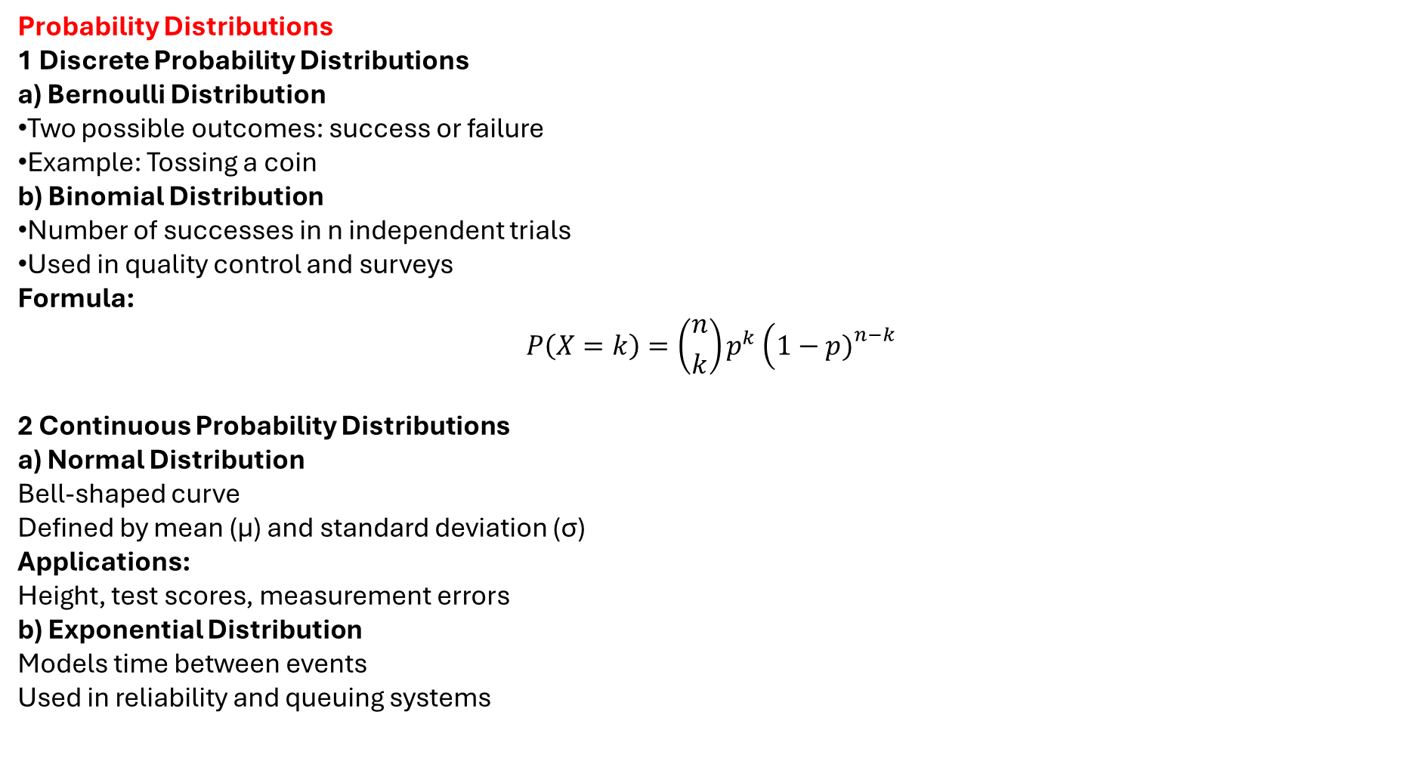
Probability Distributions
1 Discrete Probability Distributions
a) Bernoulli Distribution
Two possible outcomes: success or failure
Example: Tossing a coin
b) Binomial Distribution
Number of successes in n independent trials
Used in quality control and surveys
Formula:
$$P\left(X=k\right)=\left({n \atop k}\right)p^{k}\left(1−p{\left.)\right.}^{n−k}\right.$$
2 Continuous Probability Distributions
a) Normal Distribution
Bell-shaped curve
Defined by mean (μ) and standard deviation (σ)
Applications:
Height, test scores, measurement errors
b) Exponential Distribution
Models time between events
Used in reliability and queuing systems

Slide 9
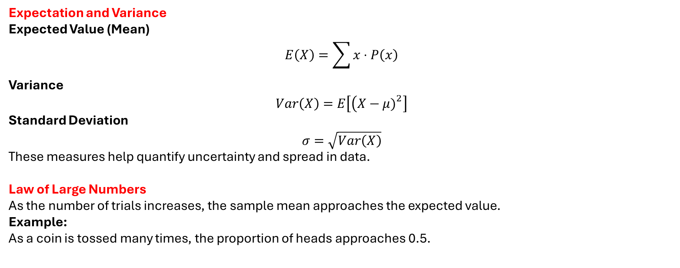
Expectation and Variance
Expected Value (Mean)
$$E\left(X\right)=\sum{x}⋅P\left(x\right)$$
Variance
$$Var\left(X\right)=E\left[\left(X−μ{\left.)\right.}^{2}\right]\right.$$
Standard Deviation
$$σ=\sqrt{Var\left(X\right)}$$
These measures help quantify uncertainty and spread in data.
Law of Large Numbers
As the number of trials increases, the sample mean approaches the expected value.
Example: As a coin is tossed many times, the proportion of heads approaches 0.5.

Slide 10
Central Limit Theorem (CLT)
The CLT states that the distribution of sample means tends toward a normal distribution as sample size increases, regardless of the original distribution.
Importance in Data Science
Enables hypothesis testing
Supports confidence interval estimation
Foundation of many ML algorithms
Applications of Probability in Data Science
Machine Learning: Model uncertainty and predictions
Risk Analysis: Financial and insurance modeling
A/B Testing: Comparing user behavior
Natural Language Processing: Language modeling
Computer Vision: Object detection probabilities
Probability forms the mathematical foundation of data science. It helps quantify uncertainty, make predictions, and model real-world phenomena. Concepts such as random variables, distributions, Bayes’ theorem, and conditional probability are essential tools used across machine learning, artificial intelligence, statistics, and data analytics. A strong understanding of probability enables data scientists to build accurate, reliable, and interpretable models.

Slide 11
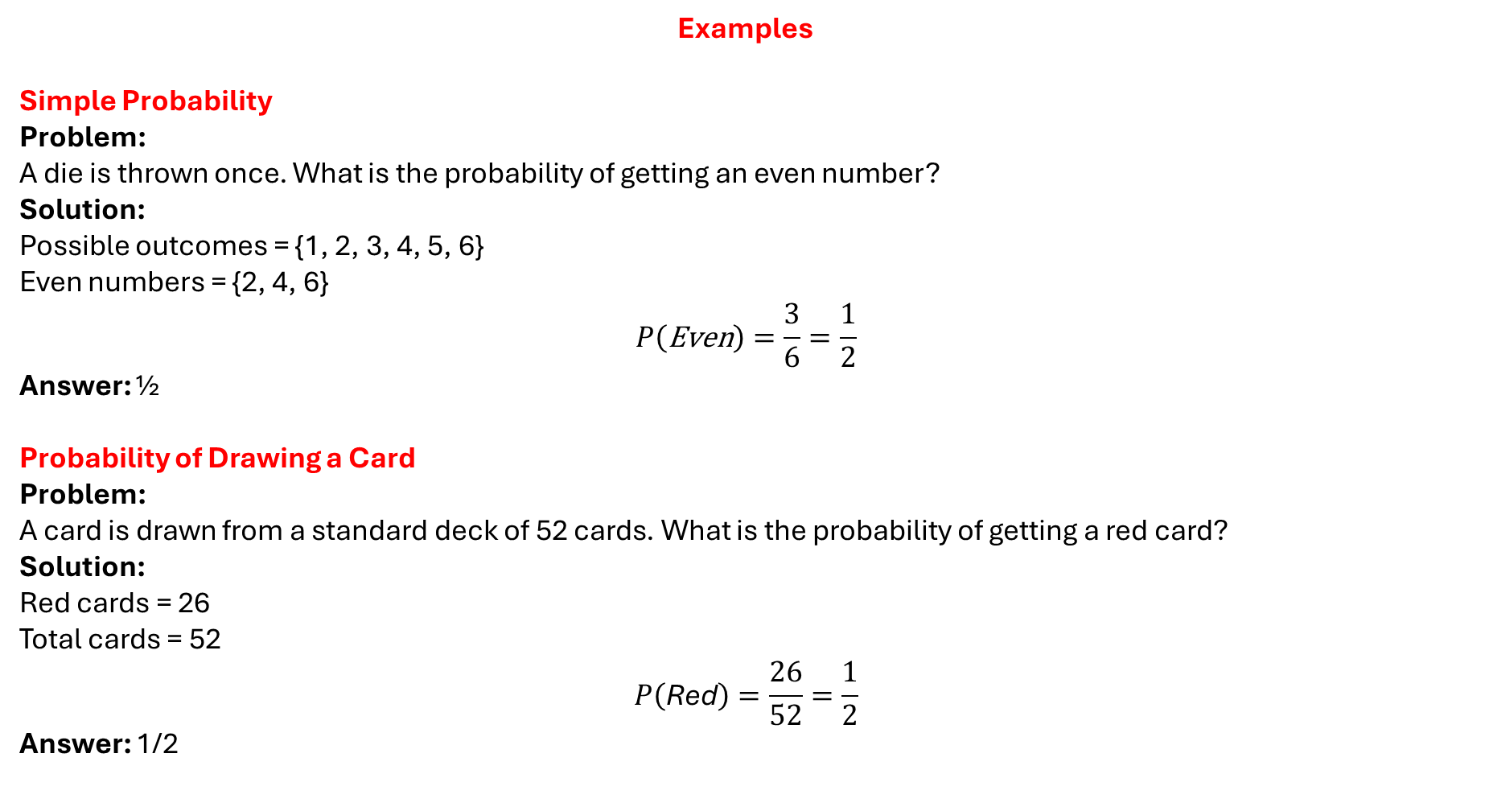
Examples
Simple Probability
Problem: A die is thrown once. What is the probability of getting an even number?
Solution: Possible outcomes = {1, 2, 3, 4, 5, 6} Even numbers = {2, 4, 6}
$$P\left(\text{Even}\right)=\frac{3}{6}=\frac{1}{2}$$
Answer: ½
Probability of Drawing a Card
Problem: A card is drawn from a standard deck of 52 cards. What is the probability of getting a red card?
Solution: Red cards = 26 Total cards = 52
$$P\left(\text{Red}\right)=\frac{26}{52}=\frac{1}{2}$$
Answer: 1/2

Slide 12
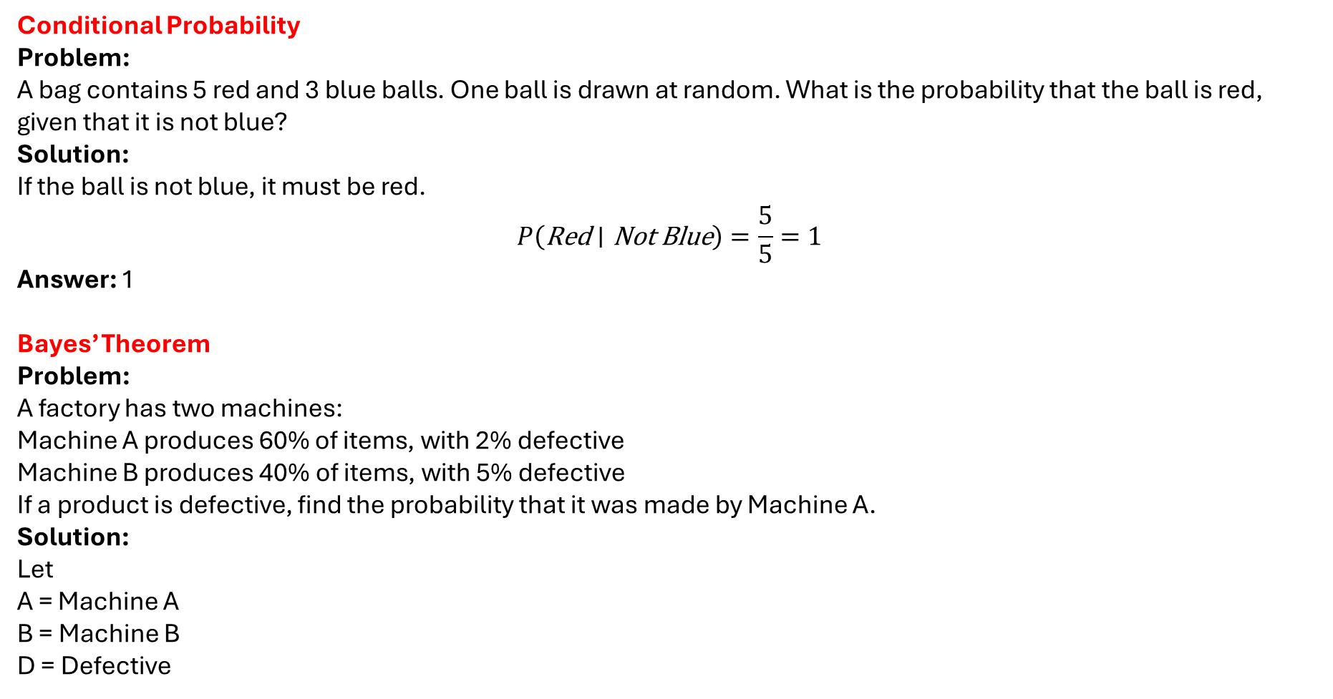
Conditional Probability
Problem: A bag contains 5 red and 3 blue balls. One ball is drawn at random. What is the probability that the ball is red, given that it is not blue?
Solution: If the ball is not blue, it must be red.
$$P\left(\text{Red}∣\text{Not} \text{Blue}\right)=\frac{5}{5}=1$$
Answer: 1
Bayes’ Theorem
Problem: A factory has two machines:
Machine A produces 60% of items, with 2% defective
Machine B produces 40% of items, with 5% defective
If a product is defective, find the probability that it was made by Machine A.
Solution:
Let A = Machine A B = Machine B D = Defective

Slide 13
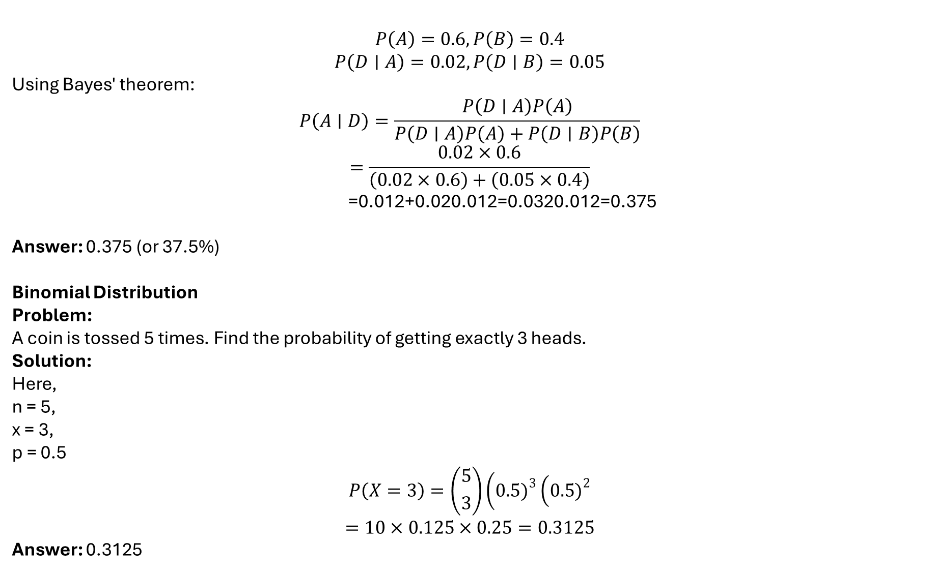
$$P\left(A\right)=0.6, P\left(B\right)=0.4$$
$$P\left(D∣A\right)=0.02, P\left(D∣B\right)=0.05$$
Using Bayes' theorem:
$$P\left(A∣D\right)=\frac{P\left(D∣A\right)P\left(A\right)}{P\left(D∣A\right)P\left(A\right)+P\left(D∣B\right)P\left(B\right)}$$
$$=\frac{0.02×0.6}{\left(0.02×0.6\right)+\left(0.05×0.4\right)}$$
=0.012+0.020.012​=0.0320.012​=0.375
Answer: 0.375 (or 37.5%)
Binomial Distribution
Problem: A coin is tossed 5 times. Find the probability of getting exactly 3 heads.
Solution: Here, n = 5, x = 3, p = 0.5
$$P\left(X=3\right)=\left({5 \atop 3}\right)\left(0.5{\left.)\right.}^{3}\left(0.5{\left.)\right.}^{2}\right.\right.$$
$$=10×0.125×0.25=0.3125$$
Answer: 0.3125

Slide 14
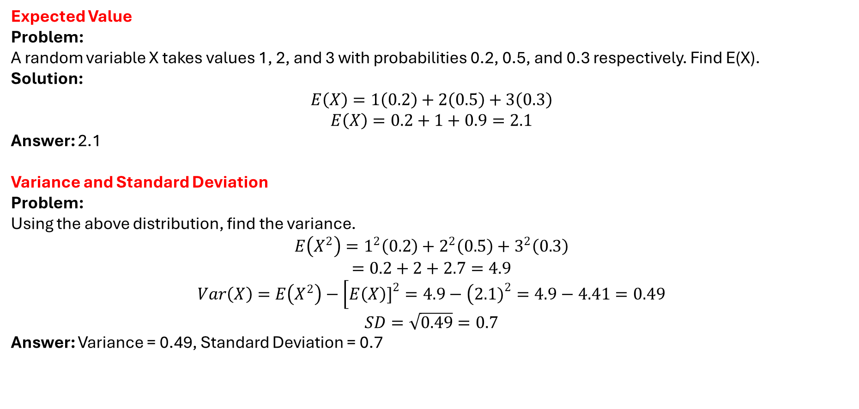
Expected Value
Problem: A random variable X takes values 1, 2, and 3 with probabilities 0.2, 0.5, and 0.3 respectively. Find E(X).
Solution:
$$E\left(X\right)=1\left(0.2\right)+2\left(0.5\right)+3\left(0.3\right)$$
$$E\left(X\right)=0.2+1+0.9=2.1$$
Answer: 2.1
Variance and Standard Deviation
Problem: Using the above distribution, find the variance.
$$E\left(X^{2}\right)=1^{2}\left(0.2\right)+2^{2}\left(0.5\right)+3^{2}\left(0.3\right)$$
$$=0.2+2+2.7=4.9$$
$$Var\left(X\right)=E\left(X^{2}\right)−\left[E\left(X\right){\left.]\right.}^{2}=4.9−\left(2.1{\left.)\right.}^{2}=4.9−4.41=0.49\right.\right.$$
$$SD=\sqrt{0.49}=0.7$$
Answer: Variance = 0.49, Standard Deviation = 0.7

Slide 15
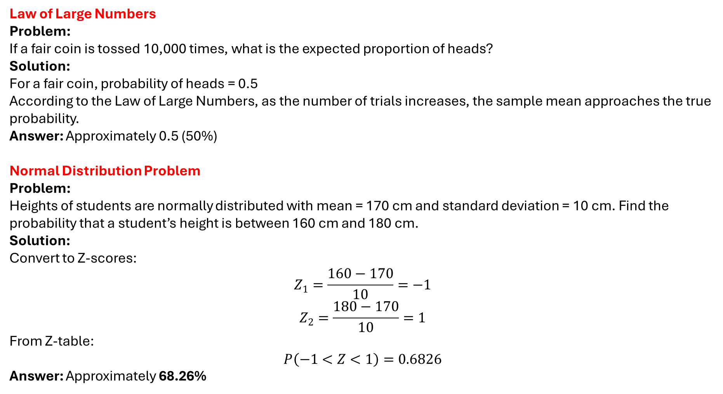
Law of Large Numbers
Problem: If a fair coin is tossed 10,000 times, what is the expected proportion of heads?
Solution: For a fair coin, probability of heads = 0.5 According to the Law of Large Numbers, as the number of trials increases, the sample mean approaches the true probability.
Answer: Approximately 0.5 (50%)
Normal Distribution Problem
Problem: Heights of students are normally distributed with mean = 170 cm and standard deviation = 10 cm. Find the probability that a student’s height is between 160 cm and 180 cm.
Solution: Convert to Z-scores:
$$Z_{1}=\frac{160−170}{10}=−1$$
$$Z_{2}=\frac{180−170}{10}=1$$
From Z-table:
$$P\left(−1<Z<1\right)=0.6826$$
Answer: Approximately 68.26%

